Slide 1
4/20 Triangle Midsegment

Slide 2
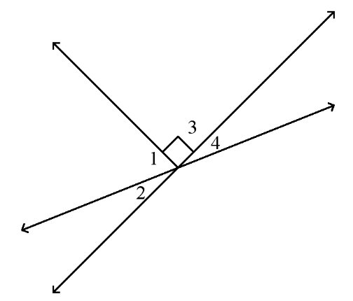
Do Now
If m∠1=3x and m∠4=3x–6 in the diagram below, find m∠2 if ∠3 is a right angle.
Hint: <1 + <3 + <4 = 180
Essential Question: How can we determine the midsegment of a triangle?

Slide 3
Agenda
Do Now
Good Things
Review
Triangle Sum Theorem
Exterior Angle Theorem
Properties of Isosceles Triangles
Notes: Midsegment of a Triangle
Exit Ticket

Slide 4
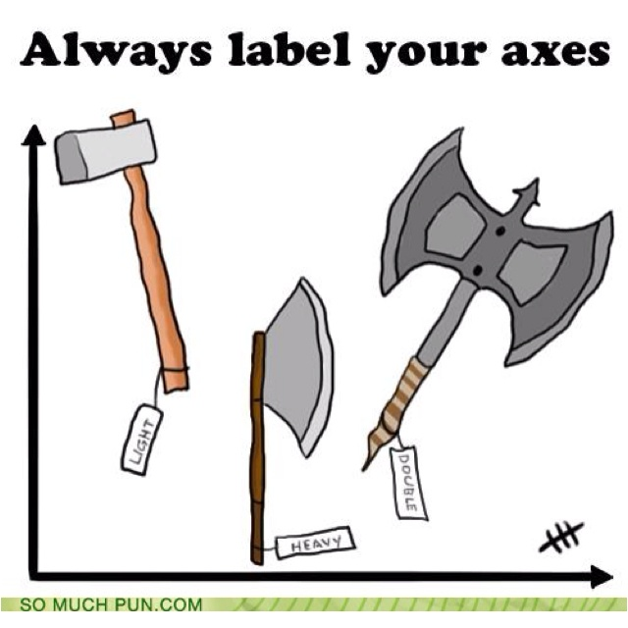
Good Things!

Slide 5
Review: Triangle Congruence Postulates
The order that we name triangles in is very important!
∆ABC is congruent to ∆XYZ
What do we know to be true?
5 congruence postulates (rules that help us prove triangles are congruent
SSS, SAS, ASA, AAS, HL

Slide 6
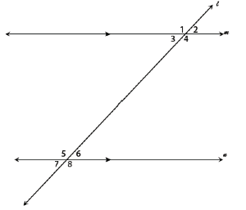
Review: Transversals
List all of the congruent angles
Alternate interior
Alternate exterior
Corresponding
Vertical
List all of the supplementary angles
Same side interior
Same side exterior

Slide 7
Review: Transversals
Find m<5 if m<3 = 6x + 18
and m<5 = 12x.

Slide 8
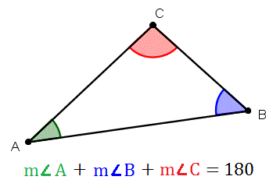
Review: Triangle Sum Theorem
Find m<B.

Slide 9
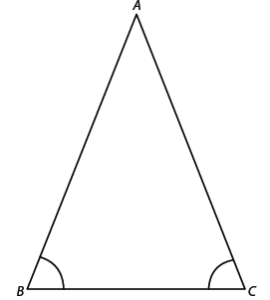
Notes: Isosceles Triangles
The base angles of an isosceles triangle are congruent
The legs of an isosceles triangle are congruent

Slide 10
Review: Isosceles Triangles
Find m<A.

Slide 11
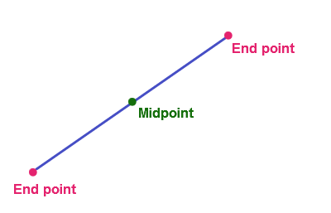
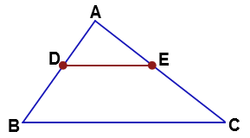
Notes: Triangle Midsegment Theorem
The midpoint is the point on a line segment that divides it into two equal parts.
Midsegment of a triangle - a line segment that joins the midpoints of two sides of a triangle
Midpoint
Midsegment
Notes:
The midpoint of AB is D
The midpoint of AC is E
The midsegment is line DE

Slide 12
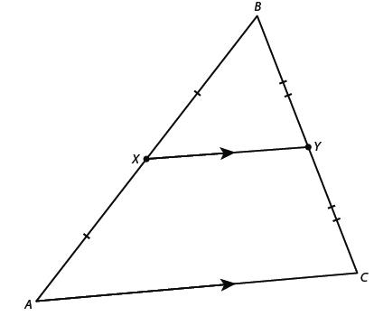
Notes: Triangle Midsegment Theorem
A midsegment of a triangle is parallel to the base and is half as long as the base.
___ ___
AC || XY
___ ___
XY = ½ * AC

Slide 13
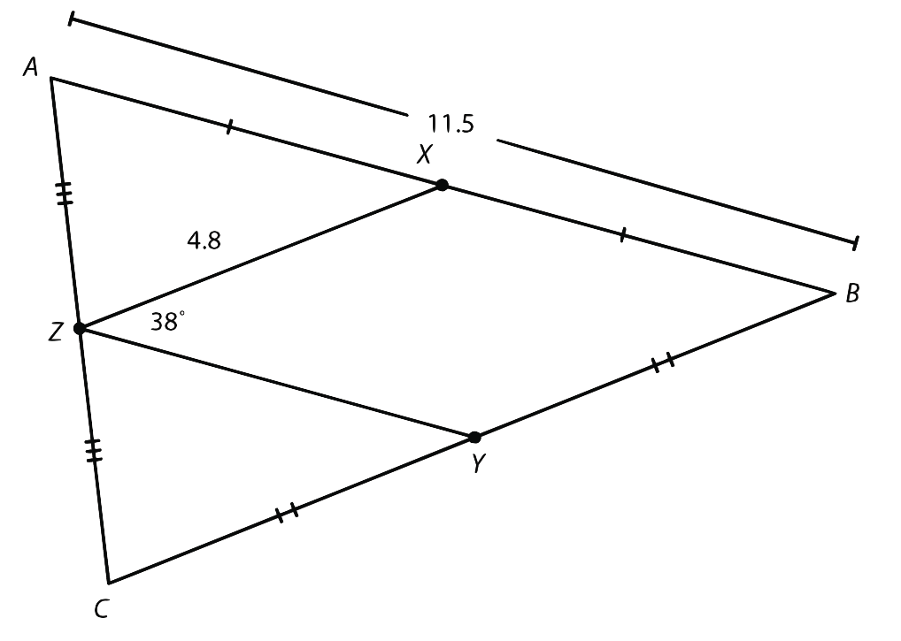
Triangle Midsegment Theorem
Find the lengths of side BC and side YZ
What do we know?
How can we solve for BC?
How can we solve for YZ?
Notes:
Solve for BC by using the midsegment XZ and multiplying it by 2
Solve for YZ by dividing AB by 2
AXZ → think of it like a transversal. If ZY is parallel to AB, then Angle AXZ is an alternate interior angle to XZY, so they are congruent → 38 degrees

Slide 14
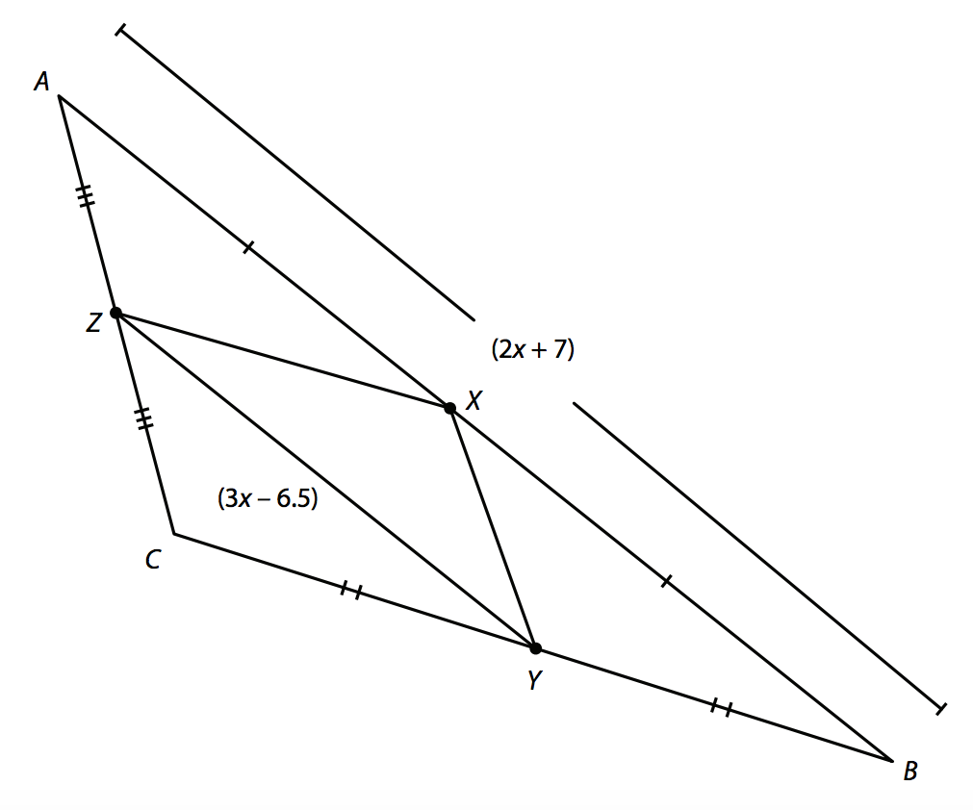
Triangle Midsegment Theorem
If AB = 2x + 7 and YZ = 3x – 6.5, what is the length of AB?

Slide 15
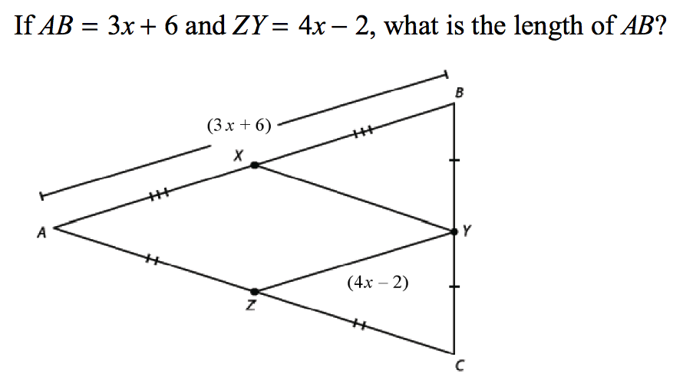
Your Turn!

Slide 16
Partner Practice Worksheet
This worksheet is your exit ticket
We will do a self-check at the end of class
My goal is for this to help you on the independent practice that is due tomorrow!
You will be graded on the work you do in class, NOT on how many you get correct

