Slide 1
1. Please complete the last sections of your SKILL BUILDER now. 2. Please turn in your HOMEWORK to the box. 3.Pick up your WEEKEND SKILL BUILDER.

Slide 2
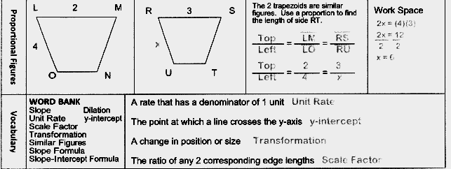

Slide 3
Solve for x.
x + 61°
x + 21°
x + 23°

Slide 4
Angles
When the sides of a polygon are extended, other angles are formed.
The original angles are the interior angles.
The angles that form linear pairs with the interior angles are the exterior angles.

Slide 5
Exterior Angle Theorem (your new best friend)
The measure of an exterior angle in a triangle is the sum of the measures of the 2 remote interior angles
remote interior
angles
exterior angle
2
1
3
4
m<1 + m<2 = m<4

Slide 6
Exterior Angle Theorem
An exterior angle of a triangle…
… is equal in measure to the sum of the measures of its two remote interior angles.
remote
interior
angles
Exterior angle

Slide 7
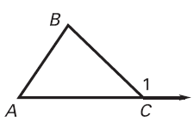
Exterior Angle Theorem
m∠1 = m∠A + m∠B

Slide 8
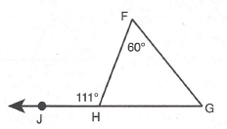
Examples
m<G = 111 - 60

Slide 9
Examples
Find x & y
82°
y = 30 + 82
y = 112˚
30°
x
y
180 = 30 + 82 + x
180 = 112 + x
68˚ = x
x = 68°
y = 112°

Slide 10
SoLVE FOR X.
x = 146 - 77
x = 69˚

Slide 11
Find the measure of angle GFD.
m∠GFD = 24 + 34
m∠GFD = 58°

Slide 12
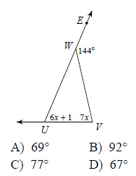
Find the measure of ∠V.

Slide 13
#9 Solve for x.
30
8 + 6x
4x + 2
Finding Missing Angles Circuit # 1-10

Slide 14
#10 Solve for x.
5x + 10
58°
11x + 2

