Slide 1
Welcome to fundamental math
You have 2 teachers!
Mrs. Petway Mr. Potter
Objective: understand class expectations
Observe patterns

Slide 2
expectations
Be seated when the bell rings
Bring supplies to class
phones should be put away
Respect yourself and others
Raise your hand for permission to speak or get up
BE considerate! Think before you speak! We cannot help you, if you are rude!

Slide 3
Syllabus
be present - meet every day
Grade policy – Tests 50% , quizzes 35%, classwork and homework 15%
Missed days = missed work; be responsible and email me when you are out so that you can get the work
Try, try, try…. Sometimes the work will be hard but don’t give up

Slide 4
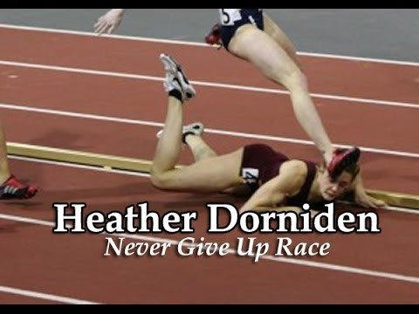
What do you do when you fall?

Slide 5
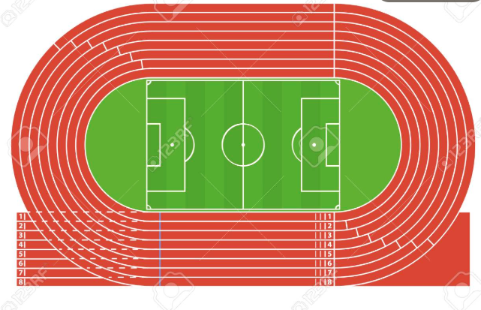
How far do you think the class can walk around a track in a minute? How long would it take to walk all the way around the track, as a class?

Slide 6
What is Rate?
A comparison of two different measurements
Example – miles per hour
Why is this important?
Which is the better buy?
6 pounds of chicken for $9.60 or 4 pounds of chicken for $5.60

