Slide 1
9-5 Symmetry
You drew reflections and rotations of figures.
Identify line and rotational symmetries in two-dimensional figures.
Identify line and rotational symmetries in three-dimensional figures.

Slide 2
Definitions
A figure has symmetry is there exists a rigid motion (reflection, translation, rotation, or glide reflection that maps the figures unto itself.
Line of symmetry is a line that can be drawn through a plane figure so that the figure on one side is the reflection image of the figure on the opposite side. It can also be referred to axis of symmetry.
A figure has line symmetry (or reflection symmetry) if the figure can be mapped onto itself by a reflection in a line of symmetry.
p. 663

Slide 3
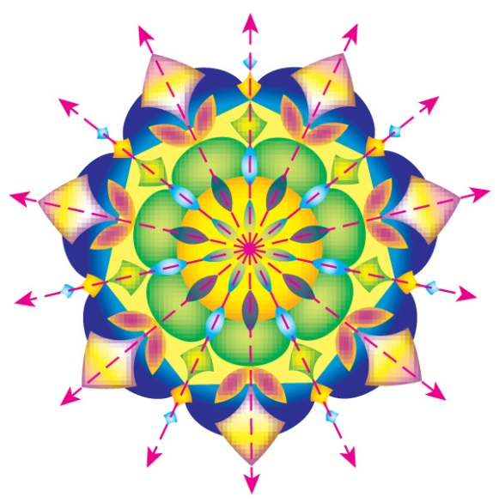
A. KALEIDOSCOPES State whether the object appears to have line symmetry. Write yes or no. If so, draw all lines of symmetry, and state their number.
Answer: yes; 7 lines of symmetry

Slide 4
B. KALEIDOSCOPES State whether the object appears to have line symmetry. Write yes or no. If so, draw all lines of symmetry, and state their number.
Answer: no

Slide 5
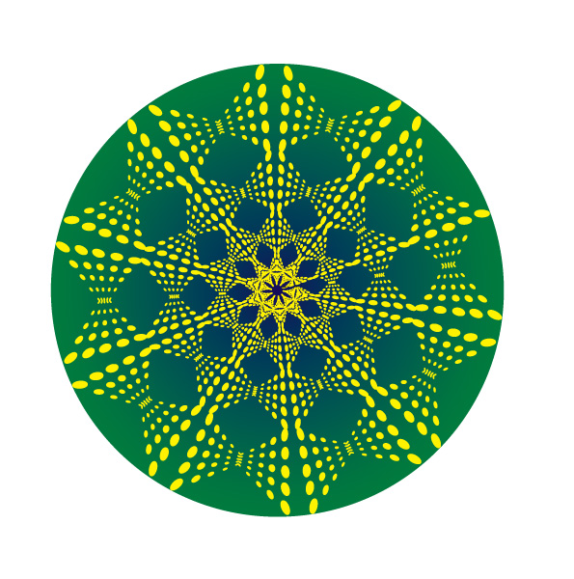
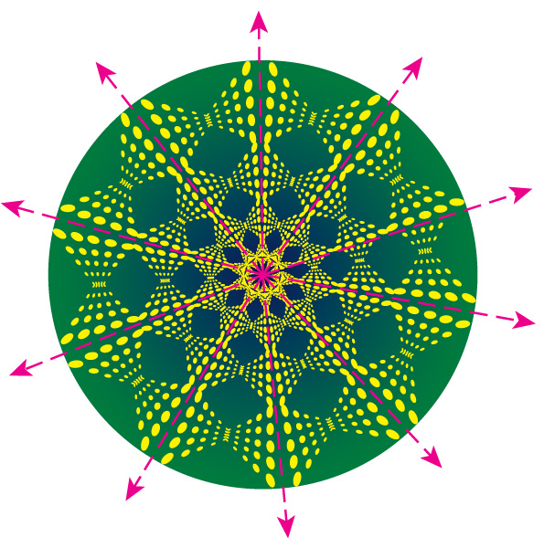
C. KALEIDOSCOPES State whether the object appears to have line symmetry. Write yes or no. If so, draw all lines of symmetry, and state their number.
Answer: yes; 5 lines of symmetry

Slide 6
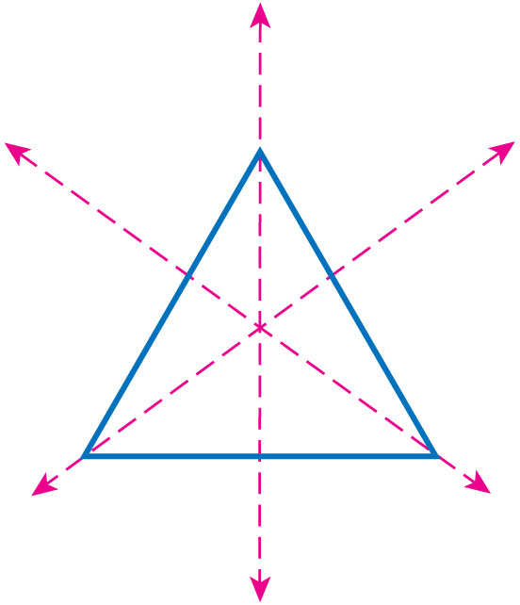
A. State whether the figure appears to have line symmetry. Write yes or no. If so, state their number.
A. yes; 1 line
B. yes; 2 lines
C. yes; 3 lines
D. no

Slide 7
B. State whether the figure appears to have line symmetry. Write yes or no. If so, state their number.
A. yes; 1 line
B. yes; 2 lines
C. yes; 4 lines
D. no

Slide 8
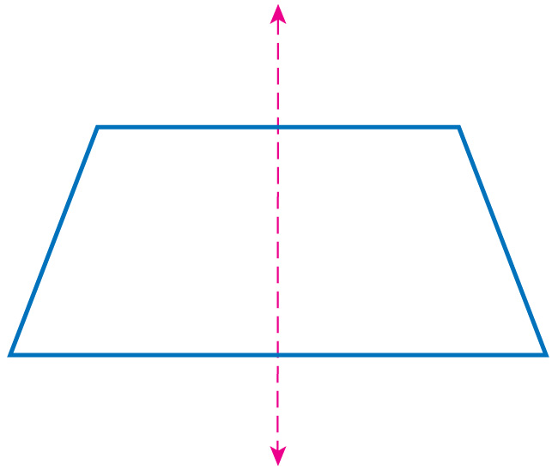
C. State whether the figure appears to have line symmetry. Write yes or no. If so, state their number.
A. yes; 1 line
B. yes; 2 lines
C. yes; 4 lines
D. no

Slide 9
Definitions
If a figure can be rotated less than 360° about a point so that the image and the preimage are indistinguishable, the figure has rotational symmetry.
Point of symmetry – a figure that can be mapped onto itself by a rotation of 180°. It is also known as center of symmetry.
p. 664

Slide 10
Definitions
Order of symmetry – the number of times a figure maps onto itself as it rotates from 0° to 360°.
The magnitude of symmetry – the smallest angle through which a figure can be rotated so that it maps onto itself. It can also be called the angle of rotation.
The order and magnitude of a rotation are related by:
Magnitude = 360°$÷$ order

Slide 11
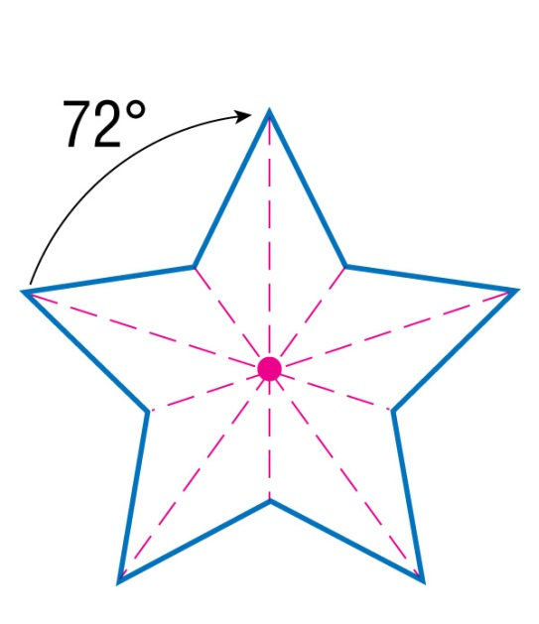
Identify Rotational Symmetry
A. State whether the figure has rotational symmetry. Write yes or no. If so, locate the center of symmetry, and state the order and magnitude of symmetry.
Answer: Yes the star has order 5 rotatonal symmetry and magnitude 360 ÷ 5 = 72°. The center of the star is the center of rotation.

Slide 12
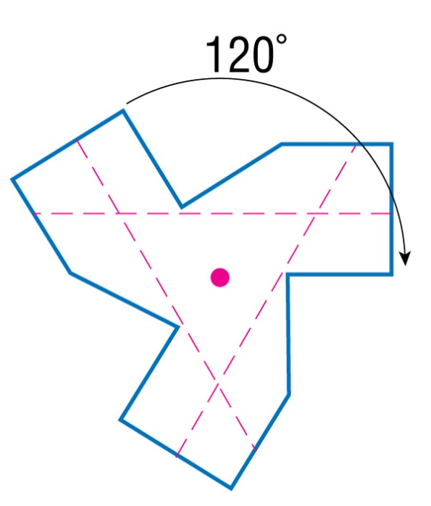
B. State whether the figure has rotational symmetry. Write yes or no. If so, locate the center of symmetry, and state the order and magnitude of symmetry.
Answer: The propeller has order 3 rotational symmetry and magnitude 360 ÷ 3 = 120°. The center of the propeller is the center of rotation.

Slide 13
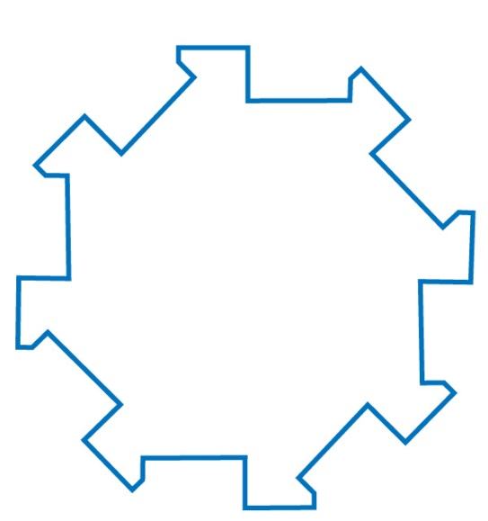
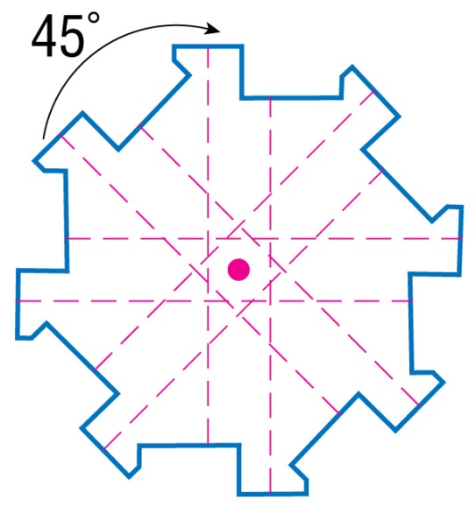
C. State whether the figure has rotational symmetry. Write yes or no. If so, locate the center of symmetry, and state the order and magnitude of symmetry.
Answer: The gear has order 8 rotational symmetry and magnitude 360 ÷ 8 = 45°. The center of the gear is the center of rotation.

Slide 14
A. State whether the figure has rotational symmetry. If so, state the order and magnitude of symmetry.
A. Yes, order 8 and magnitude 45°
B. Yes, order 4 and magnitude 90°
C. Yes, order 4 and magnitude 180°
D. No, the figure does not have rotational symmetry.

Slide 15
B. State whether the figure has rotational symmetry. If so, state the order and magnitude of symmetry.
A. Yes, order 8 and magnitude 45°
B. Yes, order 6 and magnitude 60°
C. Yes, order 4 and magnitude 90°
D. No, the figure does not have rotational symmetry.

Slide 16
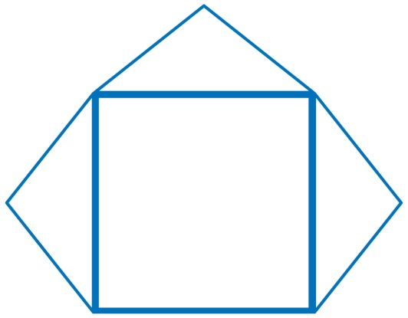
C. State whether the figure has rotational symmetry. If so, state the order and magnitude of symmetry.
A. Yes, order 3 and magnitude 90°
B. Yes, order 4 and magnitude 90°
C. Yes, order 2 and magnitude 180°
D. No, the figure does not have rotational symmetry.

Slide 17
Assignment
WB

Slide 18
9-18-2019 and 9-19-2019
Complete pages 31 -42 in the workbook

