Slide 1
Exponential Growth & Decay, Half-life, Compound Interest

Slide 2
Exponential Growth
Exponential growth occurs when an quantity increases by the same rate r in each period t. When this happens, the value of the quantity at any given time can be calculated as a function of the rate and the original amount.

Slide 3
Exponential Growth
The original value of a painting is $9,000 and the value increases by 7% each year. Write an exponential growth function to model this situation. Then find the painting’s value in 15 years.
y = a(1 + r)^{t}

Slide 4
Exponential Growth
A sculpture is increasing in value at a rate of 8% per year, and its value in 2000 was $1200. Write an exponential growth function to model this situation. Then find the sculpture’s value in 2006.

Slide 5
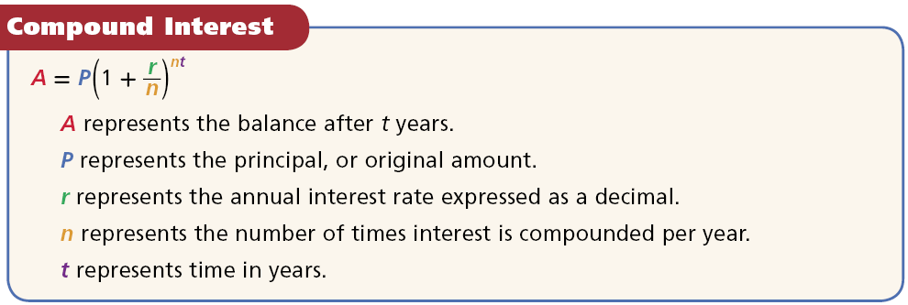
Compound Interest
For compound interest
annually means “once per year” (n = 1).
quarterly means “4 times per year” (n =4).
monthly means “12 times per year” (n = 12).

Slide 6
Compound Interest
Write a compound interest function to model each situation. Then find the balance after the given number of years. $1200 invested at a rate of 2% compounded quarterly; 3 years.

Slide 7
Compounded Interest
Write a compound interest function to model each situation. Then find the balance after the given number of years. $15,000 invested at a rate of 4.8% compounded monthly; 2years.

Slide 8
Compound Interest
Write a compound interest function to model each situation. Then find the balance after the given number of years. $1200 invested at a rate of 3.5% compounded quarterly; 4 years

Slide 9
Exponential Decay
Exponential decay occurs when a quantity decreases by the same rate r in each time period t. Just like exponential growth, the value of the quantity at any given time can be calculated by using the rate and the original amount.

Slide 10
Exponential Decay
The population of a town is decreasing at a rate of 3% per year. In 2000 there were 1700 people. Write an exponential decay function to model this situation. Then find the population in 2012.

Slide 11
Exponential Decay
The fish population in a local stream is decreasing at a rate of 3% per year. The original population was 48,000. Write an exponential decay function to model this situation. Then find the population after 7 years.

Slide 12
Half-life

Slide 13
Half-life
Astatine-218 has a half-life of 2 seconds.
Find the amount left from a 500 gram sample of astatine-218 after 10 seconds.

Slide 14
Half-life
Cesium-137 has a half-life of 30 years. Find the amount of cesium-137 left from a 100 milligram sample after 180 years.

Slide 15
Half-life
Bismuth-210 has a half-life of 5 days. Find the amount of bismuth-210 left from a 100-gram sample after 5 weeks.

Slide 16
Half-life
Astatine-218 has a half-life of 2 seconds.
Find the amount left from a 500 gram sample of astatine-218 after 1 minute.

