Slide 1
Lesson 3.9
Word Problems with Exponential Functions
Concept: Characteristics of a function
EQ: How do we write and solve exponential functions from real world scenarios? (F.LE.1,2,5)
Vocabulary: Growth Factor, Decay Factor, Percent of Increase, Percent of Decrease

Slide 2
Before we begin……
Imagine that you buy something new that you love (i.e. phone, shoes, clothes, etc.)
Later when you no longer want that item, you choose to sell it someone.
How would you decide to sell that item?
What price do you think would be a fair price?
Would you sell that item for the same price as you bought it?
Do you think that is fair?

Slide 3
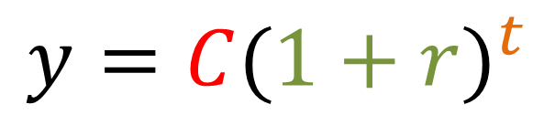
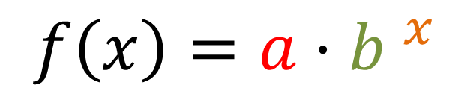
Exponential Growth
Exponential growth occurs when a quantity increases by the same percent r in each time period t.
The percent of increase is 100r
Remember if b > 1, then you will have growth.
$$y=C{(1+r)}^{t}$$
Growth rate
Initial value
Growth factor
Time Period
$$f\left(x\right)=a{ ·b }^{x}$$

Slide 4
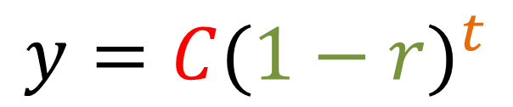
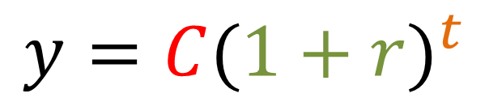
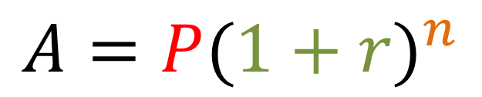
Exponential Growth Exponential Decay
Exponential Money Growth
Step 1: Write the formula you’re using.
Step 2: Substitute the needed quantities into your formula.
Step 3: Evaluate the formula.
Step 4: Interpret your answer.
$$y=C{(1+r)}^{t}$$
$$y=C{(1−r)}^{t}$$
$$A=P{(1+r)}^{n}$$

Slide 5
Example 1
A population of 40 pheasants is released in a wildlife preserve. The population doubles each year for 3 years. What is the population after 4 years?

Slide 6
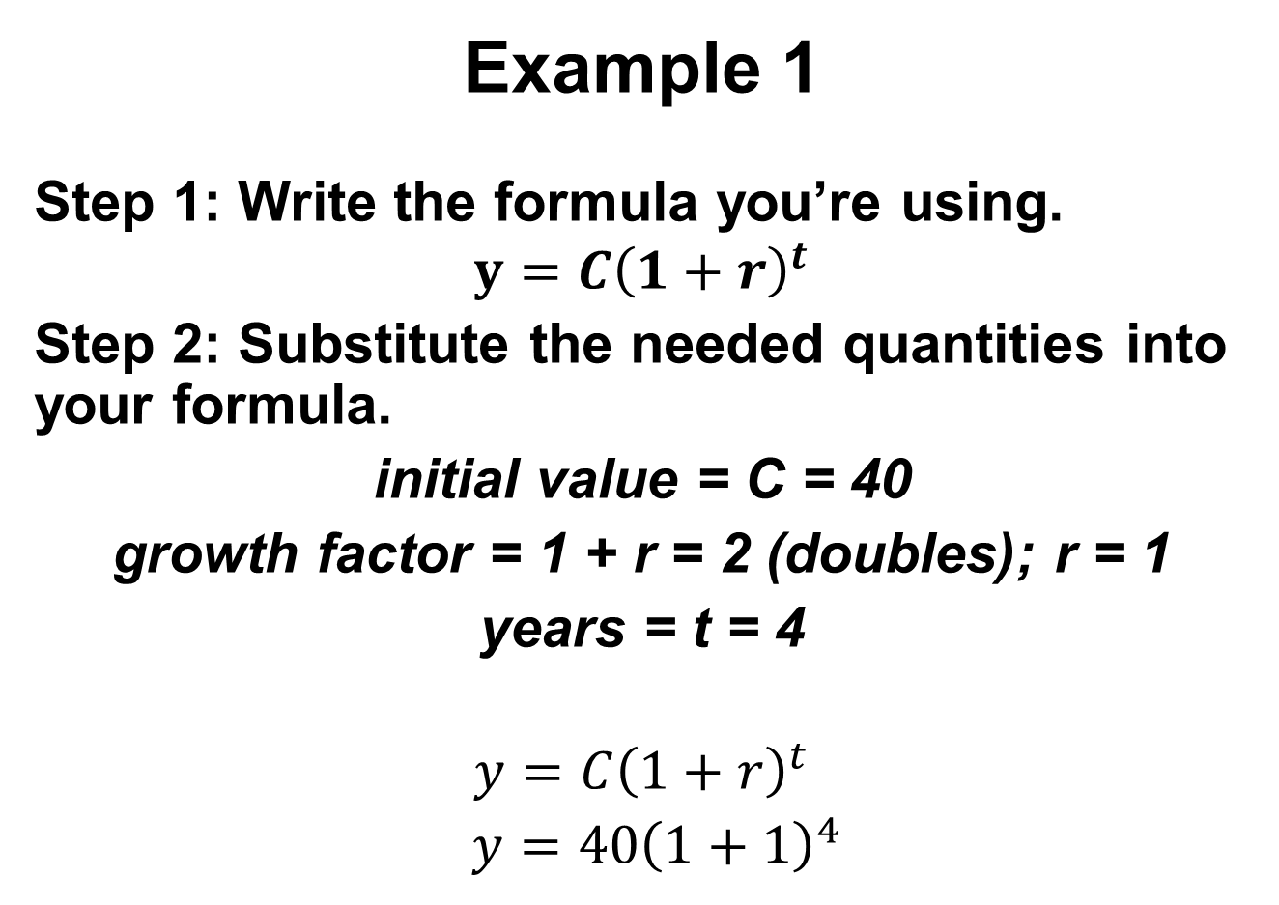
Example 1
Step 1: Write the formula you’re using.
$$y=C{\left(1+r\right)}^{t}$$
Step 2: Substitute the needed quantities into your formula.
initial value = C = 40
growth factor = 1 + r = 2 (doubles); r = 1
years = t = 4
$$y=C{\left(1+r\right)}^{t}$$
$y=40{\left(1+1\right)}^{4}$

Slide 7
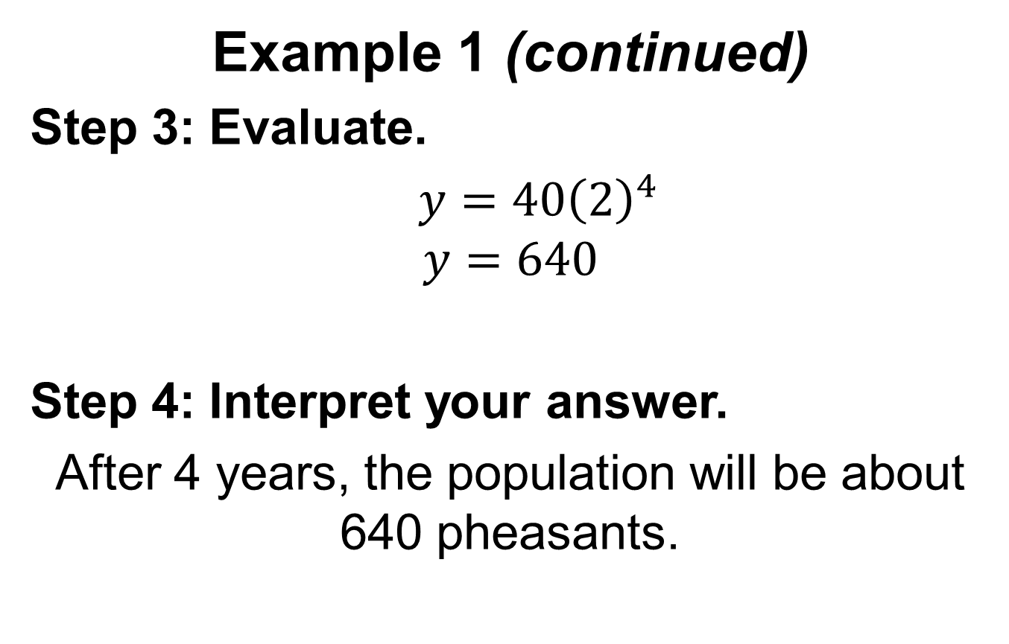
Example 1 (continued)
Step 3: Evaluate.
$y=40{\left(2\right)}^{4}$
$$y=640$$
Step 4: Interpret your answer.
After 4 years, the population will be about 640 pheasants.

Slide 8
You Try 1
Use the exponential growth model to answer the question.
$$y=C{(1+r)}^{t}$$
1. A population of 50 pheasants is released in a wildlife preserve. The population triples each year for 3 years. What is the population after 3 years?

Slide 9

Exponential Growth (Money)
When dealing with money, they change the letters used for the variables slightly. A stands for account balance, P stands for the initial value, while n stands for number of years.
The percent of increase is 100r
Remember if b > 1, then you will have growth.
$$A=P{(1+r)}^{n}$$
Growth rate
Initial value
Growth factor
Time Period
$$f\left(x\right)=a{ ·b }^{x}$$

Slide 10
Example 2
A principal of $600 is deposited in an account that pays 3.5% interest compounded yearly. Find the account balance after 4 years.

Slide 11
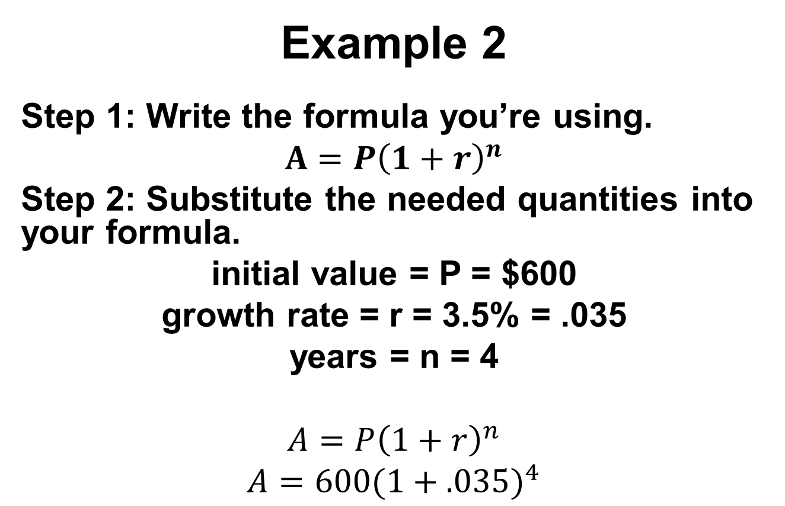
Example 2
Step 1: Write the formula you’re using.
$$A=P{\left(1+r\right)}^{n}$$
Step 2: Substitute the needed quantities into your formula.
initial value = P = $600
growth rate = r = 3.5% = .035
years = n = 4
$$A=P{\left(1+r\right)}^{n}$$
$$A=600{(1+.035)}^{4}$$

Slide 12
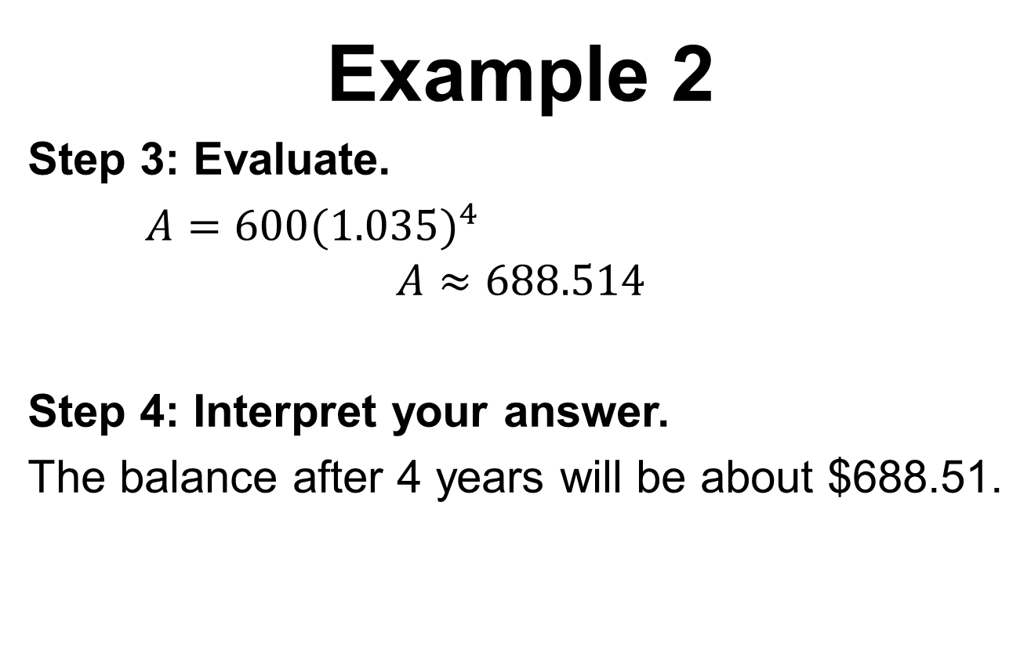
Example 2
Step 3: Evaluate.
$A=600{(1.035)}^{4}$
$$A≈688.514$$
Step 4: Interpret your answer.
The balance after 4 years will be about $688.51.

Slide 13
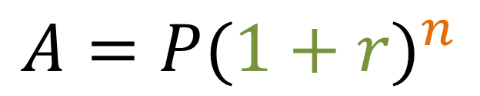
You Try 2
Use the exponential growth model to find the account balance.
$$A=P{(1+r)}^{n}$$
A principal of $450 is deposited in an account that pays 2.5% interest compounded yearly. Find the account balance after 2 years.

Slide 14
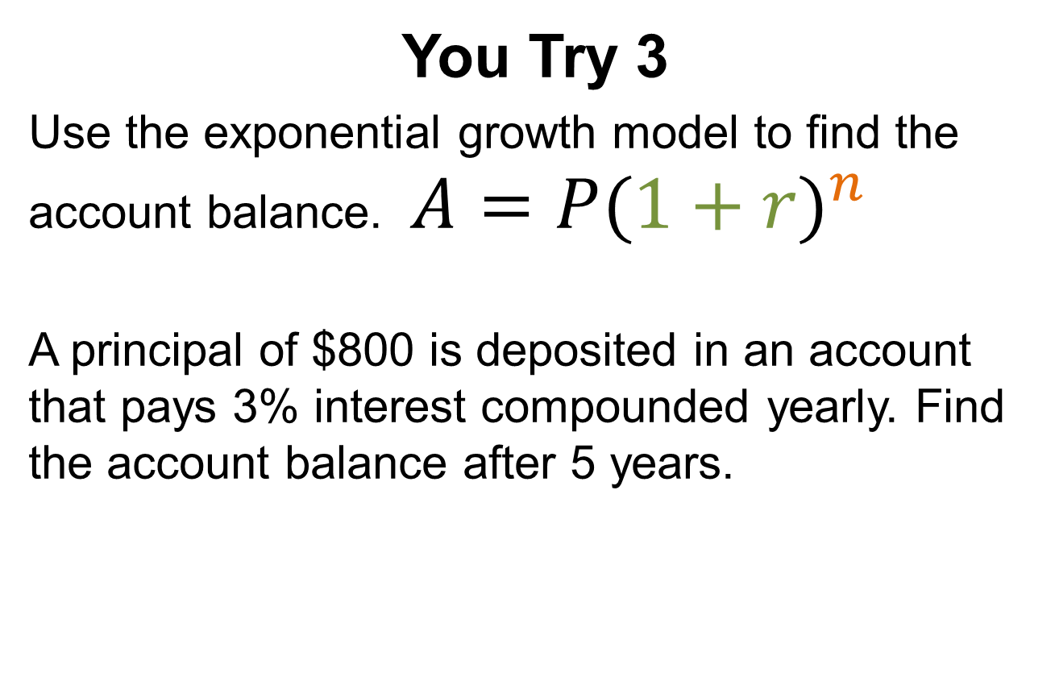
You Try 3
Use the exponential growth model to find the account balance. $A=P{(1+r)}^{n}$
A principal of $800 is deposited in an account that pays 3% interest compounded yearly. Find the account balance after 5 years.

Slide 15

Exponential Decay
Exponential decay occurs when a quantity decreases by the same percent r in each time period t.
The percent of decrease is 100r
Remember if 0 < b < 1, then you will have decay.
$$y=C{(1−r)}^{t}$$
Decay rate
Initial value
Decay factor
Time Period
$$f\left(x\right)=a{ ·b }^{x}$$

Slide 16
Example 3
You bought a used truck for $15,000. The value of the truck will decrease each year because of depreciation. The truck depreciates at the rate of 8% per year. Estimate the value of your truck in 5 years.

Slide 17
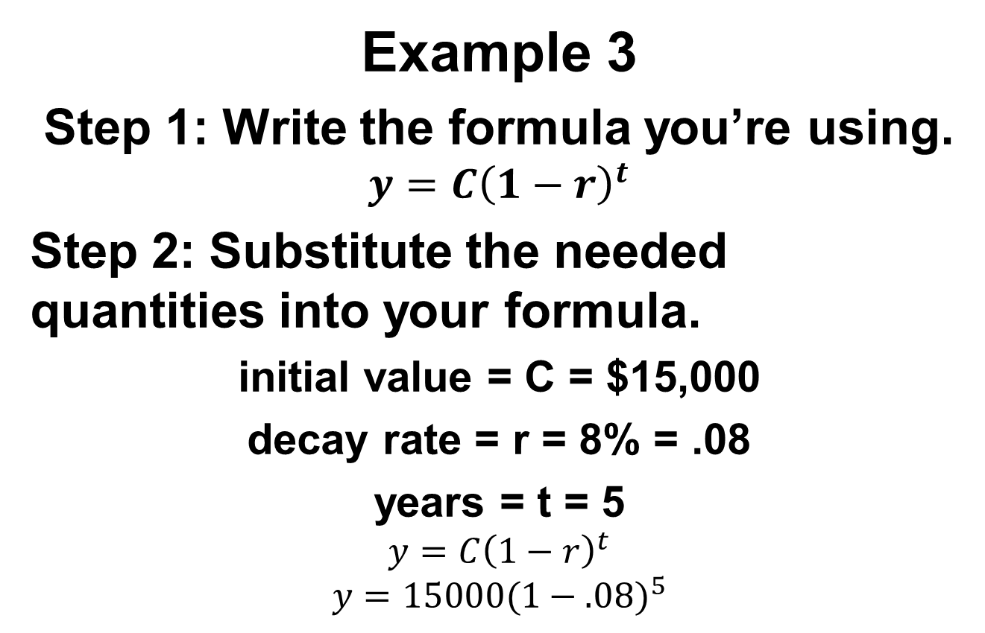
Example 3
Step 1: Write the formula you’re using.
$$y=C{\left(1−r\right)}^{t}$$
Step 2: Substitute the needed quantities into your formula.
initial value = C = $15,000
decay rate = r = 8% = .08
years = t = 5
$$y=C{\left(1−r\right)}^{t}$$
$$y=15000{(1−.08)}^{5}$$

Slide 18
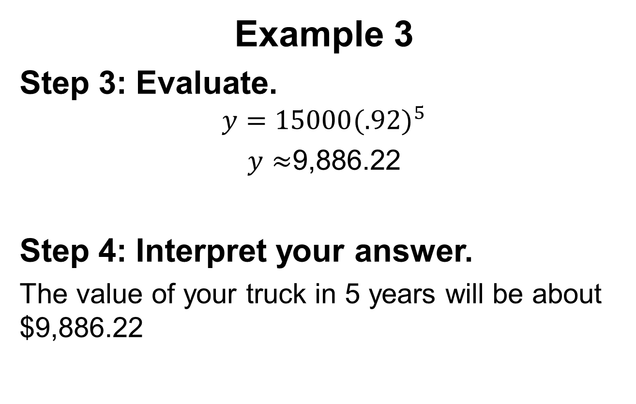
Example 3
Step 3: Evaluate.
$$y=15000{(.92)}^{5}$$
$y≈$9,886.22
Step 4: Interpret your answer.
The value of your truck in 5 years will be about $9,886.22

Slide 19
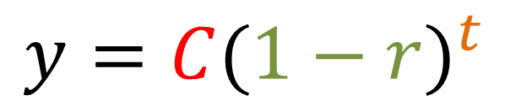
You Try 4-5
Use the exponential decay model to find the account balance.
$$y=C{(1−r)}^{t}$$
4. Use the exponential decay model in example 3 to estimate the value of your truck in 7 years.
5. Rework example 3 if the truck depreciates at the rate of 10% per year.

Slide 20
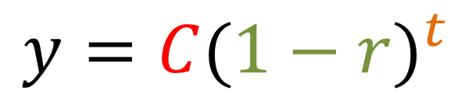
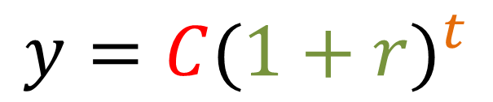
Annual Percent of Increase/Decrease
The annual percent of increase or decrease comes from the Growth and Decay factors of the exponential formulas
Identify the growth and decay factors in the formula.
$$y=C{(1+r)}^{t}$$
$$y=C{(1−r)}^{t}$$

Slide 21

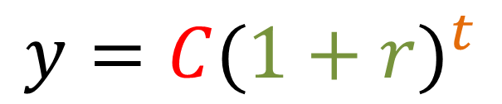
Annual Percent of Increase or Decrease
Exponential Growth Exponential Decay
Step 1: Identify if the function is a growth or a decay.
Step 2: Write the factor from the corresponding exponential formula and set it equal to the base. Growth: 1 + r = base Decay: 1 – r = base
Step 3: Solve the formula for r.
Step 4: Find the percent of increase or decrease. Use your answer from step 3 and plug it into 100r.
Growth factor
Decay factor
$$y=C{(1+r)}^{t}$$
$$y=C{(1−r)}^{t}$$

Slide 22
Annual Percent of Increase
Example 4: Find the annual percent of increase or decrease that f(x) = 2(1.25)^{x} models
Step 1: Identify if it’s a growth or a decay.
Since the base (1.25) is greater than 1, it’s a
growth.
Step 2: Look at the growth factor from the exponential formula: 1 + r and set it equal to the base
1 + r = 1.25
Step 3: Solve the formula for r 1 + r = 1.25
-1 -1
r = .25
Step 4: Find the percent of increase. So substitute your value for r into 100r--- 100(.25) = 25
The percent of increase is 25%

Slide 23
Annual Percent of Decrease
Example 5: Find the annual percent of increase or decrease that f(x) = 3(0.80)^{x} models
Step 1: Identify if it’s a growth or a decay.
Since the base (0.80) is less than 1, it’s a decay.
Step 2: Look at the decay factor from the exponential formula: 1 – r and set it equal to the base
1 - r = 0.80 1 - r = 0.80
Step 3: Solve the formula for r -1 -1
- r = -.20
-1 -1
r = .20
Step 4: Find the percent of decrease. So substitute your value for r into 100r--- 100(.20) = 20
The percent of decrease is 20%

Slide 24
Annual Percent of Decrease
Example 5: Find the annual percent of increase or decrease that f(x) = 3(0.80)^{x} models
Step 1: Identify if it’s a growth or a decay.
Since the base (0.80) is less than 1, it’s a
decay.
Step 2: Look at the decay factor from the exponential formula: 1 – r and set it equal to the base
1 – r = 0.80
Step 3: Solve the formula for r --- r = .20
Step 4: The percent of decrease is 100r, so substitute r for .20
The percent of increase is 20%

Slide 25
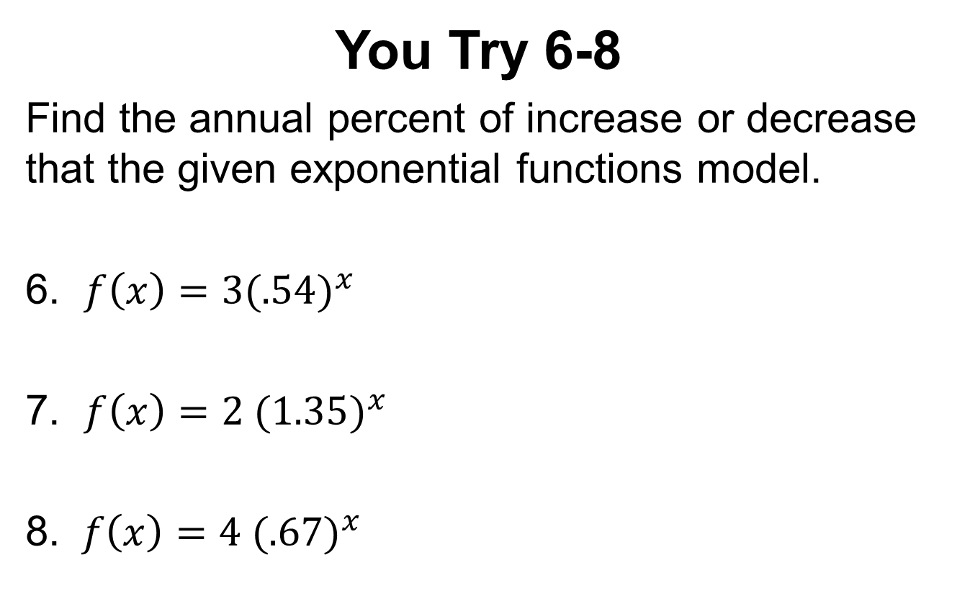
You Try 6-8
Find the annual percent of increase or decrease that the given exponential functions model.
6. $f\left(x\right)=3{(.54)}^{x}$
7. $f\left(x\right)=2 {(1.35)}^{x}$
8. $f\left(x\right)=4 {(.67)}^{x}$

Slide 26
$2.00 Summary
Create a statement using 20 words only about what you learned today. Each word is worth ten cents and you must add up to $2.00

