Slide 1
Probability

Slide 2
Uses of Probability
Probability is used all of the time in real life
Gambling
Sports
Weather
Insurance
Medical Decisions
Standardized Tests
And others

Slide 3
Definition of Probability
“The likelihood of something happening”
We use this to answer questions like:
What is the chance of rain tomorrow?
Will you win at Black Jack?
Who will win the Super Bowl?
Is the answer A, B, C, or D?
What are the chances of rolling a 13 with 2 dice?

Slide 4
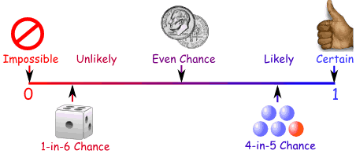
Basic Probability
$$Probability of Event= \frac{\# of successful outcomes}{\# of possible outcomes}$$
Probability is always between 0 and 1
.5

Slide 5
Sample Space
The set of all possible outcomes of an experiment.
List the sample space, S, for each of the following:
a. Tossing a coin
S = {H,T}
b. Rolling a six-sided die
S = {1,2,3,4,5,6}
c. Drawing a marble from a bag that contains two red, three blue and one white marble
S = {red, red, blue, blue, blue, white}

Slide 6
Intersections and Unions of Sets
The intersection of two sets (A AND B) is the set of all elements in both set A AND set B.
The union of two sets (A OR B) is the set of all elements in set A OR set B (or both).
Example: Given the following sets, find A and B and A or B
A = {1,3,5,7,9,11,13,15} B = {0,3,6,9,12,15}
A and B = {3,9,15}
A or B = {0,1,3,5,6,7,9,11,12,13,15}
Notes:
Stress that intersection means AND and that union means OR

Slide 7
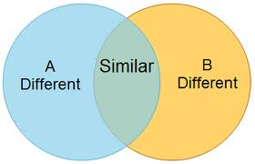
Venn Diagrams
A Venn Diagram is a visual representation of sets and their relationships to each other using overlapping circles. Each circle represents a different set.

Slide 8
Venn Diagrams
A
B
1
2
4
8
16
3
6
12
What is A ∩ B?
What is A ∪ B?

Slide 9
Example:
In a class of 60 students, 21 sign up for chorus, 29 sign up for band, and 5 take both. 15 students in the class are not enrolled in either band or chorus.
Put this information into a Venn Diagram. Let A=set of chorus students. Let B=set of band students
What is A ∩ B?
What is A ∪ B?
A
B

Slide 10
Compliment of a set
The complement of a set is the set of all elements NOT in the set.
The compliment of a set, A, is denoted as A^{C} or A’
Ex: S = {…-3,-2,-1,0,1,2,3,4,…}
A = {…-2,0,2,4,…}
If A is a subset of S, what is A^{C}?
A^{C} = {-3,-1,1,3,5,…}
Notes:
Stress that compliment means NOT

Slide 11
Basic Probability
Probability of an event occurring is:
P(E) = Number of Favorable Outcomes
Total Number of Outcomes
Notes:
Discuss with students that the probabilities of all possible outcomes must add to 1, so the probability of something not happening would be 1 minus the probability of the event occuring.

Slide 12
Practice:
A bag contains six red marbles, four blue marbles, two yellow marbles and 3 white marbles. One marble is drawn at random.
List the sample space for this experiment
Find the following probabilities:
a. P(red)
b. P(blue or white)
c. P(not yellow)

Slide 13
Addition Rule of Probability
If P(A and B) is 0, then we call A and B mutually exclusive. This means they can never happen at the same time.

Slide 14
Practice:
A card is drawn at random from a standard deck of cards.
Find the following probabilities:
a. What’s the probability of drawing a heart?
b. What’s the probability of drawing a red card?
c. What’s the probability of drawing a 2 or a jack?

