Slide 1

Math Journal 1-24
Simplify and solve.
$2+2x=16 2. 5x +23 =8$
3. $− \left(x+4\right)=11 4. \frac{1}{2}\left(2x −10\right)=12$

Slide 2
Unit 3 Day 1: Solving One- and Two-Step Equations
Essential Questions: What are inverse operations? How can we isolate a variable to figure out its value? How do we check if a value is a solution to an equation?

Slide 3
Vocabulary
Equation: the result when an equal sign (=) is placed between two expressions.
Solution: a number, when substituted for the variable, makes the equation true.
Inverse Operations: operations that “undo” each other, like addition and subtraction.

Slide 4

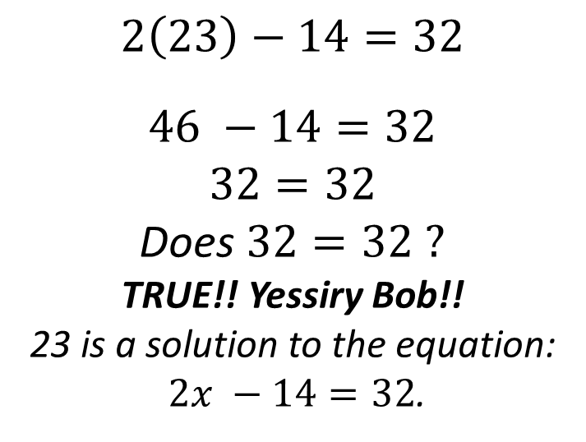
Checking Solutions
$$2x −14=32 ;x=23$$
Question: Does x = 23 satisfy this equation?
x = 23 is the value in question
Steps
Work
Step 1: Locate the given solution to the equation.
Step 2: Plug the solution into the equation.
Step 3: Simplify each side of the equation.
Step 4: Determine whether the statement is true or false.
$$x=23$$
$$2\left(23\right)−14=32$$
$$46 −14=32$$
$$32=32$$
Does $32=32 ?$
TRUE!! Yessiry Bob!!
23 is a solution to the equation:
$2x −14=32$.

Slide 5
Application Problem
Each month Drake pays a flat fee of $30 and then $.10 per minute to his cell phone company. For the month of October his total bill was $125. Drake got a call from his cell phone company telling him he had used 1,000 minutes that month and would be charged a fee.
Is this possible? Why or why not?
The equation that models Drake’s phone plan is $C= .10x+30$, where C = the cost of his bill
x = the number of minutes he talks
We know that the Cost of Drake’s phone is C = 125. We can plug this into the equation: $125 = .10x+30$
The phone company says he talked for 1000 minutes (x = 1000). We can plug this in for x and check whether or not it is a solution.
$$.10\left(1000\right)+30=25 100+30=25 130 =125 ? FALSE‼$$
If Drake talked for 1000 minutes, his bill would have been $130. The phone company made a mistake!!

Slide 6
Inverse Operations
To isolate a variable, we transform or change the equation using inverse operations.
Examples:
Addition and Subtraction
Multiplication and Division
***LAW OF OBEYING THE EQUAL SIGN***
Any change applied to one side of the equal sign
MUST!!! Be applied to the other side in order to keep the balance.
***ALWAYS OBEY THE EQUAL SIGN ***

Slide 7
Steps to Solving Equations
#1. Simplify the left and right sides, if necessary.
#2. Draw a line straight down from the equal sign to separate the left side from the right.
#3. Work to isolate the variable by undoing the addition and subtraction.
#4. Work to isolate the variable by undoing the multiplication and division.
#5. Check your answer by plugging it back into the original equation and simplify.

Slide 8
Example 1: Solve the equations.
a) r + 3 = 2 b) x – 9 = -17
c) n – (-4) = -8 d) -11 = n – (-2)
- 3
- 3
Check:
-1 + 3 = 2
2 = 2
+ 9
+ 9
Check:
-8 - 9 = -17
-17 = -17
r
= -1
x
= -8
You should continue doing this for every problem that you solve!
n + 4 = -8
-11 = n + 2
- 4
-4
- 2
- 2
n
= -12
-13 =
n

Slide 9
Example 2: Solve the equations.
a) 18 = 6x b)
c) -7b = -4 d)
y
2 ·
= 8
· 2
2
6
6
3 = x
y = 16
r
-5 ·
20 =
· -5
-5
-7
-7
-100 = r
4
b =
7

Slide 10
Example 3: Solve the equations.
a) 4x + 3 = 11 b) -2x – 15 = -41
c) d)
- 3
- 3
+ 15
+ 15
4x
= 8
-2x
= -26
4
4
-2
-2
x
= 2
x
= 13
x
1
+ 7 = -11
-
x - 9 = 11
4
2
- 7
- 7
+ 9
+ 9
x
x
4 ·
= -18
· 4
-2 ·
-
= 20
· -2
4
2
x
= -72
x
= -40

Slide 11
Example 5:
A number doubled and then increased by 7.
The result is 93. What is the original number?
$$2x+7=93$$
$$2x=86$$
$$x=43$$
The original number is 43. ☺!!

Slide 12
Example 6:
I am saving money to buy a bike. The bike costs $245. I have $125 saved, and each week I add $15 to my savings. How long will it take me to save enough money to buy the bike?
$$125+15x=245$$
$$15x=120$$
$$x=8$$
It will take me 8 weeks to save enough money to buy the bike.

Slide 13
Summary
Essential Questions: What are inverse operations? How can we isolate a variable to figure out its value? How do we check if a value is a solution to an equation?
Take 1 minute to write 2 sentences answering the essential questions.

